Slide 1

ARBA MINCH UNIVERSITY
ARBA MINCH INSTITUTE OF TECHNOLOGY
FACULTY OF COMPUTING AND SOFTWARE ENGINEERING
ARBAMICH UNIVERSITY VIRTUAL NOTICE BOARD
January 26

Slide 2
TEAM MEMBERS
ROBEL HAILU
SELMAN GETACHEW
HUNDESSA SERBESSA
NAOL BIRHANU
MAHDER ESHETU
AMIT
05
01

Slide 3
INTRODUCTION
📌 Problem Statement:
Arba Minch University currently lacks a dedicated web-based virtual notice board.
This makes it difficult to effectively share important updates, research breakthroughs, and achievements with students, faculty, alumni, and the public.
📌 Why This Is a Problem:
Vital information is scattered or delayed, reducing accessibility.
Students and faculty miss important announcements.
Research findings remain underexposed.
AMU’s contributions do not reach a broader audience.
05
03

Slide 4
EXISTING SYSTEM
Physical Notice Boards: Used for announcements but require manual updates.
Verbal Announcements: Shared in meetings and classrooms but lack consistency.
Social Media Platforms: Some updates are posted on Facebook, Telegram, etc., but these are scattered and unverified.
AMU Website: AMU have simple website along with SMIS ,but it lacks categorization and management
AMU Previous Links
www.amu.edu.et/ https://t.me/arbaminch_university - https://www.facebook.com/ArbaMinchUniversity
AMIT
07
02
08

Slide 5
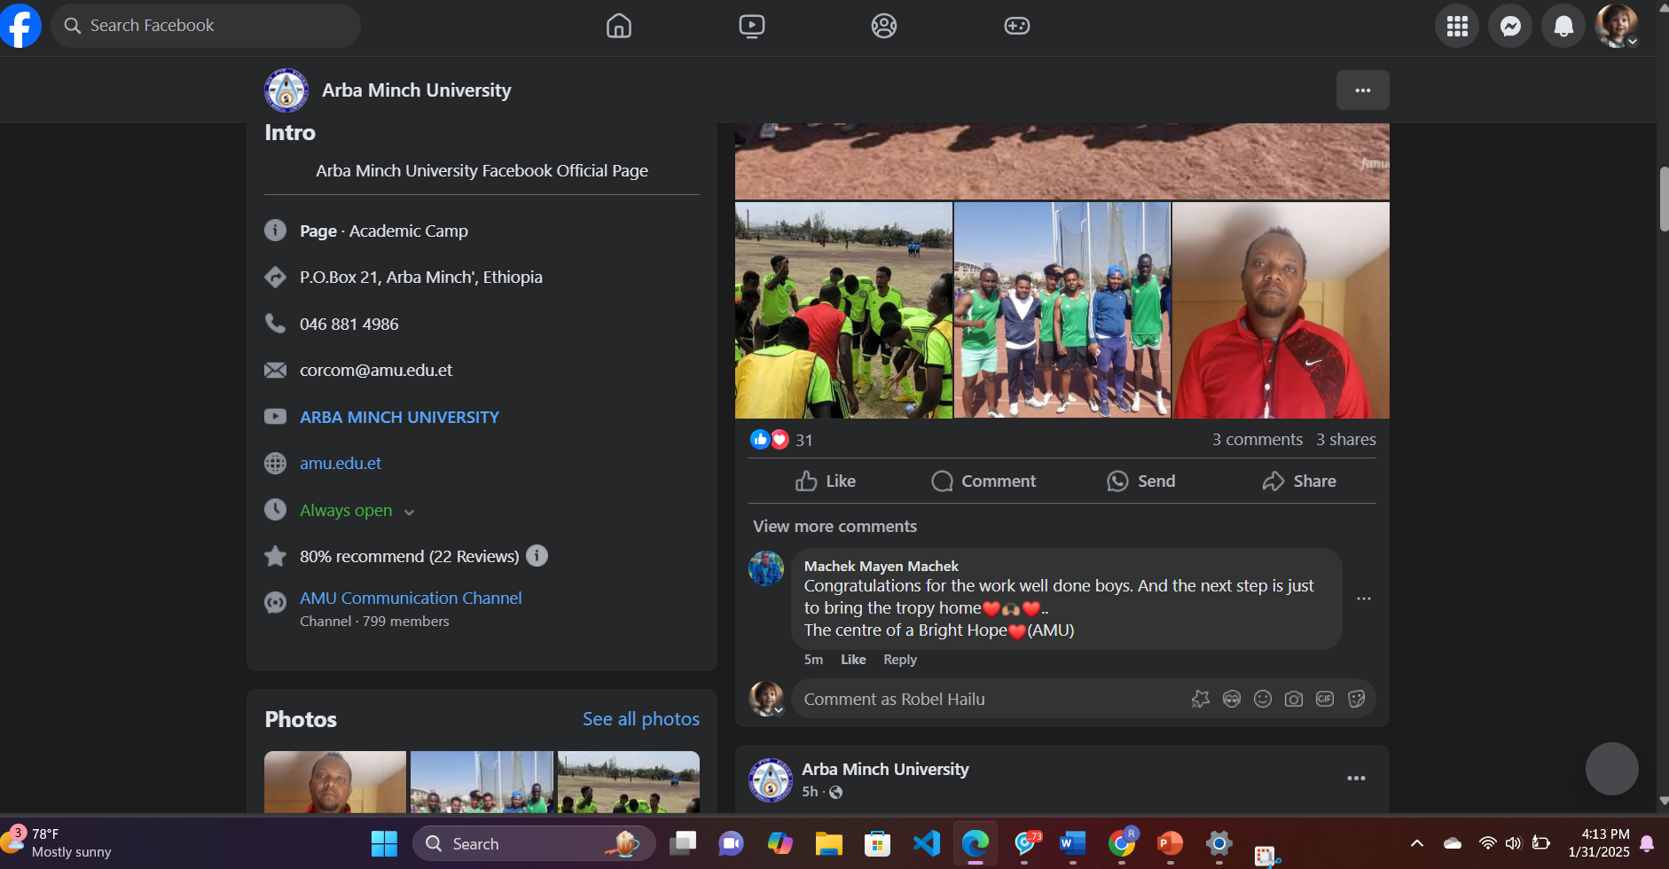
Amu Facebook

Slide 6
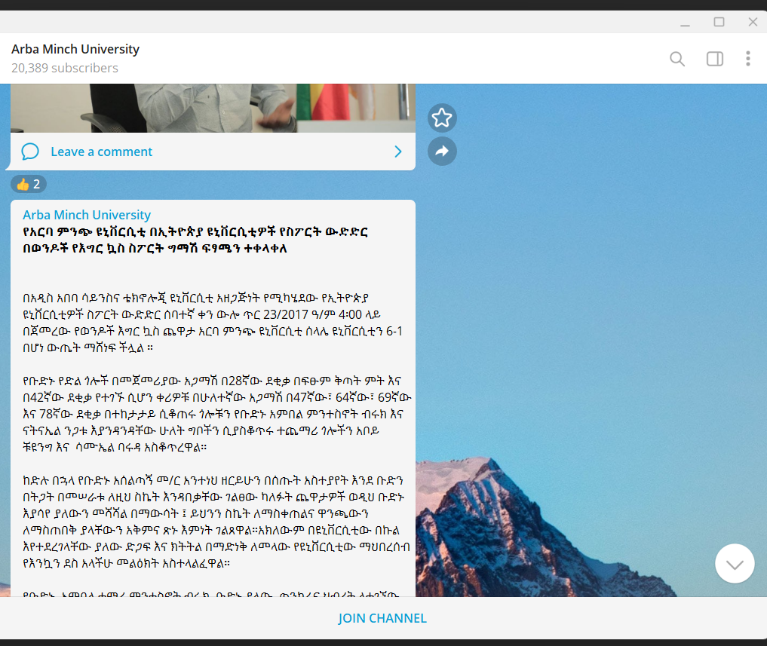
Telegram

Slide 7

Noticed board

Slide 8
Major Functions in the Existing System
Players in the System:
Students & Other Stakeholders
They receive updates through social media, emails, and notice boards.
Faculty & Administrative Offices
They draft news and announcements related to their respective departments . submit content to the AMU Communication Office for review.
AMU Communication Office
They act as the central hub for reviewing and publishing announcements. They ensure proper formatting, consistency, and security before posting on platforms.
05
03

Slide 9
Cont …
Content Drafting and Submission
Administrative offices and faculty draft content and send it to the communication office.
Review and Publication
The communication office reviews and posts content on Telegram, Facebook, and email.
Content Sharing
Text, images, and videos are shared primarily through social media platforms.
05
AMIT
04

Slide 10
Challenges of the Existing System:
The current system has several inefficiencies that impact its effectiveness:
Performance Delays
Due to the manual process, news dissemination is slow and inefficient.
Inaccurate & Redundant Content
Without a centralized system, duplicate and sometimes inconsistent news is shared.
Security Risks
Unauthorized individuals can post fake news, and hacking risks exist for social media accounts.
06
05
AMIT

Slide 11
Challenges of the Existing System:
Cont …
4. Lack of Efficiency & Integration
The manual review and submission process consume time and resources.
There is no tracking or analytics to measure engagement.
5. Limited Reporting Capabilities
The system relies on basic social media analytics (likes, shares), which do not provide actionable insights.
06
AMIT
05

Slide 12
Proposed System
Key Improvements:
Establishes a centralized platform for university-related news and updates.
Enhances efficiency, security, and communication consistency across the university.
Provides a seamless and user-friendly experience for students, faculty, and staff.
Key Features:
Responsive & User-Friendly Interface – Ensures smooth navigation across all devices (desktop, tablet, mobile).
Secure User Authentication – Restricts publishing rights to authorized university staff using role-based access.
Personalized Content Filtering – Users can customize news preferences (e.g., academic updates, events, research).
07

Slide 13
Proposed System
Advanced Features & Security Enhancements
Powerful Functionality for Improved Access & Protection: 🔍 Advanced Search Engine – Allows users to find news using keywords, dates, or categories quickly. 🔒 Enhanced Security & Data Integrity – Implements encryption, secure hosting, and regular data backups. 📢 Real-Time Communication & Updates – Ensures instant news dissemination, keeping the university community well-informed.
07
05

Slide 14
Stakeholders
University Administration
Faculty & Teaching Staff
Students and Instructors
IT & System Administrators
University Media & Communications Team
Event Coordinators
Research Departments & Scholars
Alumni & External Partners
08

Slide 15
Feasibility Analysis
Feasibility Analysis Overview
📌 Purpose: Evaluate the viability of the proposed News Feed system. 📌 Key Areas of Analysis: ✔️ Operational Feasibility – User adoption & efficiency. ✔️ Technical Feasibility – Technology, skills & scalability. ✔️ Economic Feasibility – Cost-effectiveness & sustainability. ✔️ Behavioral/Political Feasibility – Stakeholder support & policy alignment. ✔️ Schedule Feasibility – Realistic development timeline.
12
05

Slide 16
Cont …
📍 Operational Feasibility
User-friendly & accessible for students, staff & admin.
Automates news updates, reducing workload.
📍 Technical Feasibility
Uses scalable tech: React.js, Node.js, Mongodb.
University has the required IT infrastructure.
📍 Economic Feasibility
Developed using existing university resources (low cost).
No external hiring, minimal maintenance expenses.
12
05

Slide 17
Cont …
Political & Schedule Feasibility + Cost
📍 Behavioral/Political Feasibility
Strong support from students & faculty.
Aligns with university policies & security guidelines.
📍 Schedule Feasibility
Parallel development of front-end & back-end.
Well-defined timeline with stakeholder collaboration.
📍 Estimated Cost: 75,700 Birr
Software (Development, hosting, testing) – 56,700 Birr
Hardware (Servers, backup storage) – 19,000 Birr
Excluding the cloud storage cost for image and video
12
05

Slide 18

Technology Stack
• Frontend: React.js & Tailwind CSS
• Backend: Node.js , Express.js & Docker.js
• Database: MongoDB
• Development Tools: Git, GitHub, VS Code
• Event management : JIRA
•Storage: not decided firebase or other.
AMU virtual notice Board
13

Slide 19
Functional requirement
Input Requirements:
User registration (User ID/Email, Password)
Login (User ID/Email, Password)
Admin adds new categories
Process Requirements:
User authentication during login
Validation of registration inputs
Display all news posts
Output Requirements:
Success/error messages for login/registration
Updated categories after new category addition
Display news posts by category and time
05
16

Slide 20
Functional requirement
Storage Requirements:
Store encrypted User ID/Email and Password
Store news post details (Title, Description, Attachments)
Log user activities (Registration, Login, News posts)
Security Requirements:
Encrypted storage for user credentials
Secure data transmission via HTTPS
Restricted admin access
Auto log-out after 15 minutes of inactivity
16
05

Slide 21
Non Functional requirement
Usability:
User-friendly, minimal tech knowledge required
Clear error messages and guidance
Supports common browsers and mobile-friendly
Availability:
99.9% uptime, excluding scheduled maintenance
24-hour notice for maintenance
Reliability, Scalability, Maintainability:
Automated backups to prevent data loss
1-hour recovery time after server failure
Modular system for easy updates
16
05

Slide 22
Testing Strategy
📌 Unit Testing
📌 Integration Testing
📌 User Acceptance Testing
📌 Regression Testing
05
18
05

Slide 23
THANK YOU
19

